Slide 1
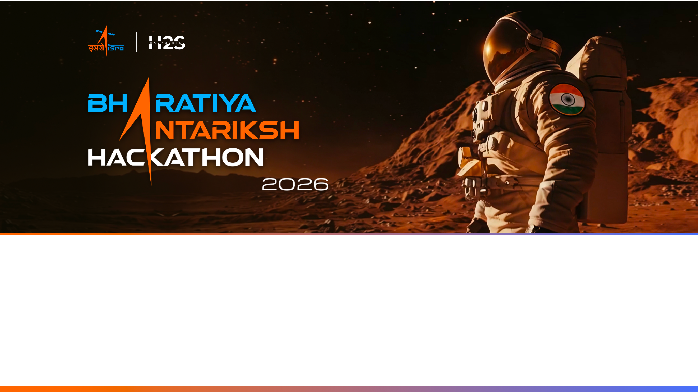
Team Name : PS10 solver
Team Leader Name : Parth Tripathi
Problem Statement : Infrared image colorization and enhancement for improved object interpretation

Slide 2

Team Members
Team Leader: Name: Parth Tripathi College: IIT Hyderabad | Team Member-1: Name: Parth College: HBTI kanpur
Team Member-2: Name: Bhavya Mittal College:Guru Gobind Singh Indraprastha University (GGSIPU), Delhi

Slide 3
Opportunity should be able to explain the following:
How different is it from any of the other existing ideas?
Problem
Satellite imagery plays a vital role in agriculture, disaster management, urban planning, environmental monitoring, and defense. However, many archived and real-time satellite images suffer from:
Low spatial resolution
Limited visual details
Grayscale imagery from older sensors
Loss of fine features due to sensor limitations
These issues reduce the effectiveness of image interpretation and downstream applications.
Proposed Solution
Develop an AI-powered framework capable of:
Enhancing low-resolution satellite images to high-resolution images.
Automatically colorizing grayscale satellite imagery.
Preserving geographical structures and textures.
Producing visually realistic images suitable for analysis and visualization.

Slide 4
Opportunity should be able to explain the following:
USP of the proposed solution
Single unified framework
Preserves fine geographical details
Generates realistic color information
Satellite-domain optimized
Supports multiple Earth observation datasets
Faster inference for operational deployment
How will it be able to solve the problem?
Existing Solutions
Current methods:
Traditional interpolation (Bicubic, Lanczos)
Generic super-resolution models
Separate pipelines for super-resolution and colorization
Limited preservation of remote sensing features
Our Innovation
We propose a deep learning framework that jointly learns:
Satellite-specific Super Resolution
Automatic Image Colorization
Perceptual texture preservation
Edge-aware reconstruction

Slide 5
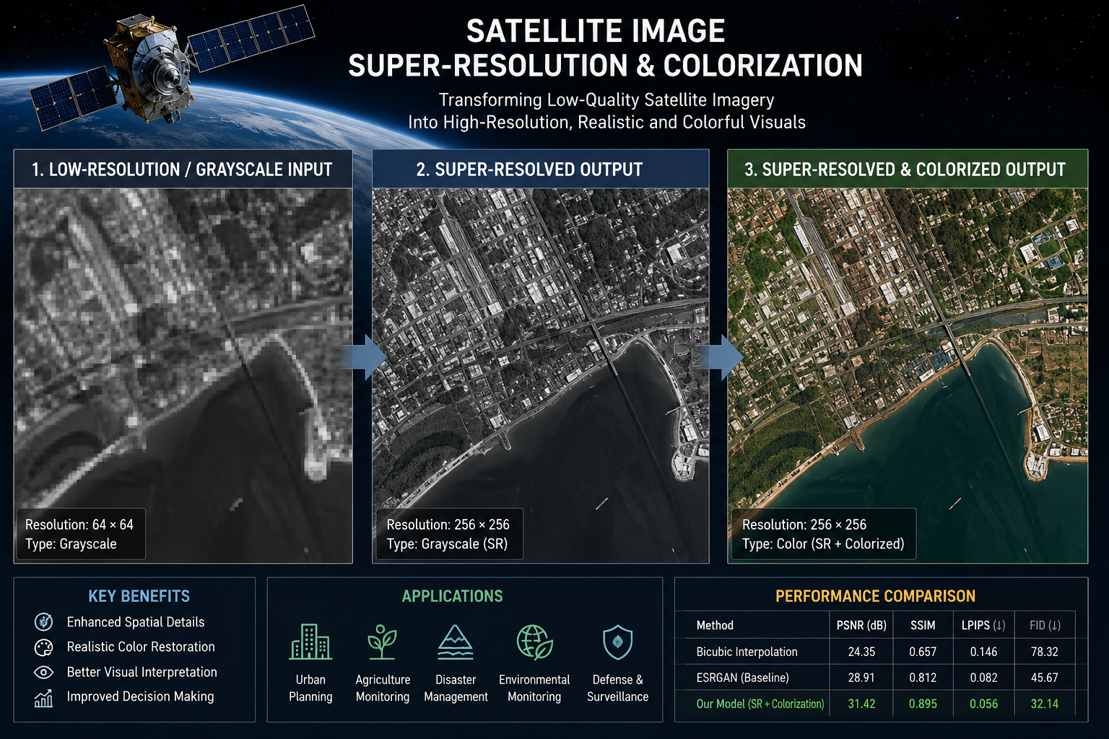
Key Features :
4× Super Resolution
Automatic grayscale-to-RGB colorization
Edge-preserving reconstruction
Cloud-compatible inference
Supports multiple satellite datasets
Batch image processing
High PSNR and SSIM performance
Ready for GIS visualization

Slide 6
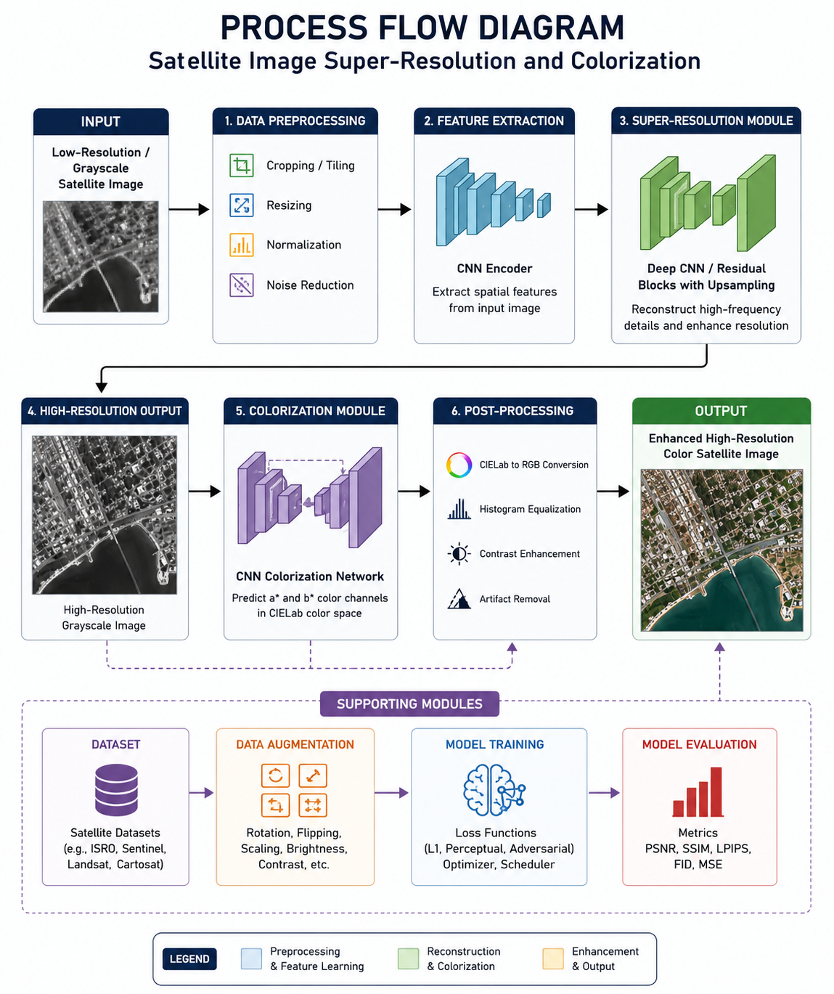
Process flow diagram
Low Resolution /
Grayscale Satellite Image
Image Preprocessing
Deep Learning Model
Post Processing
Super Resolution
Colorization Network
Enhanced High Resolution
Color Satellite Image

Slide 7
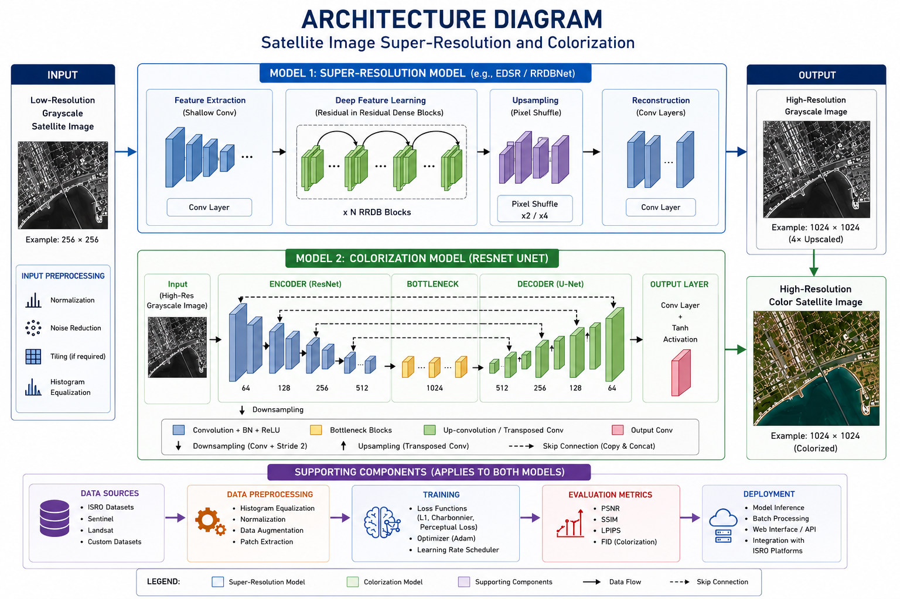

Slide 8
Technologies to be used in the solution:
Programming
Python
Deep Learning
PyTorch
TensorFlow
OpenCV
Models
CNN
Residual Networks
Attention Mechanisms
GAN (optional)
Vision Transformers (future scope)
Image Processing
NumPy
Pillow
Scikit-image
Evaluation Metrics
PSNR
SSIM
LPIPS
FID
MSE
Deployment
Streamlit
Docker

Slide 9
Estimated implementation cost (optional):
Component | Estimated Cost
Satellite Dataset | Free (ISRO/Open datasets)
Software | Open Source
GPU Training | ₹20,000–₹40,000 (Cloud, if needed)
Deployment | ₹5,000–₹10,000
Total | < ₹50,000

Slide 10
